Slide 1
Preliminary results Conv vs Div rotation E26 (2018-2022) Plot 3
02/12/2025
Agustin Olivo
aolivo@uoguelph.ca

Slide 2
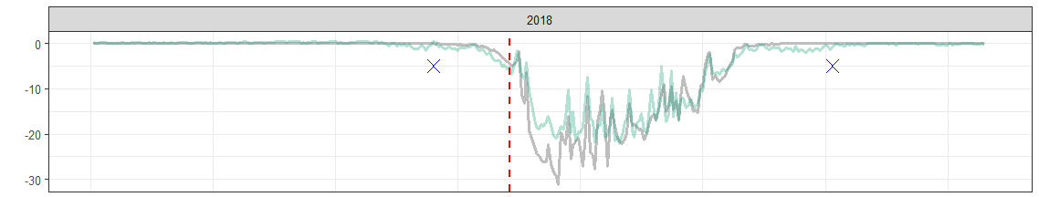
If using “cover crop” or “alfalfa” (looks like the latest changes did not push back cover crop development)

Slide 3
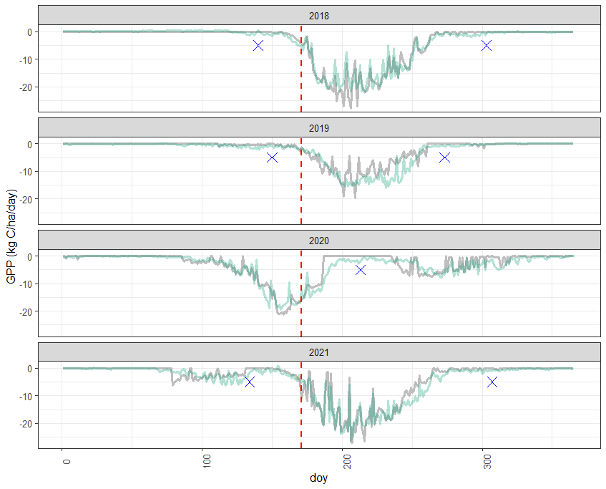
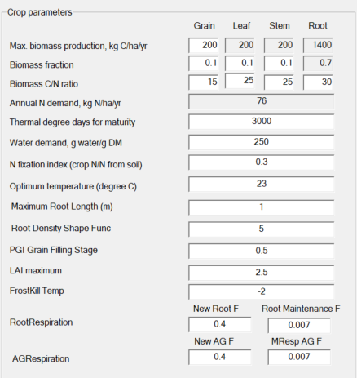
If using “rye”
If lower values are used, GPP turns to 0 in late fall and spring.

Slide 4
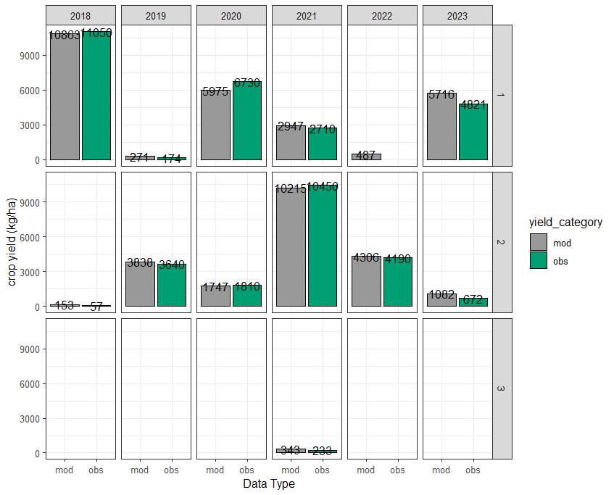

Slide 6
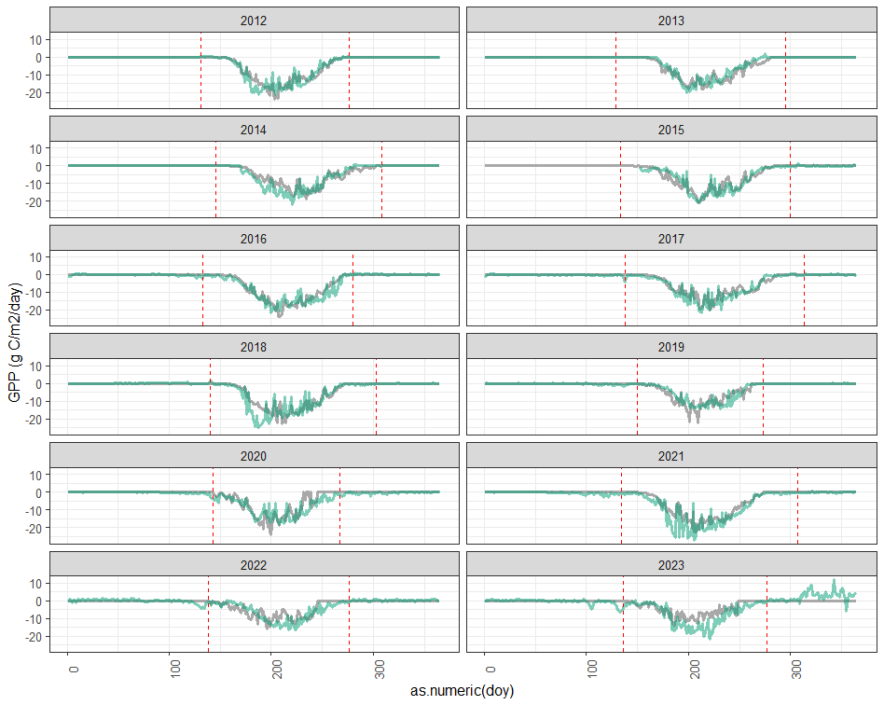

Slide 7
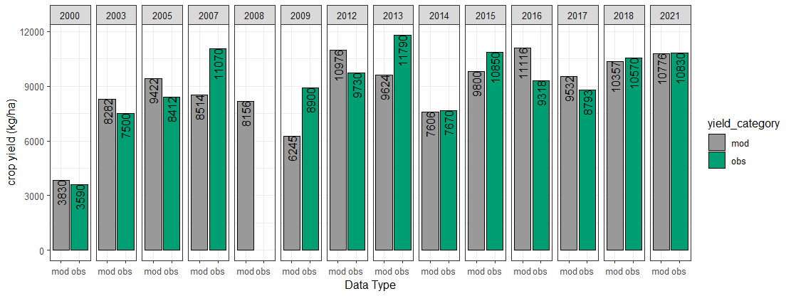
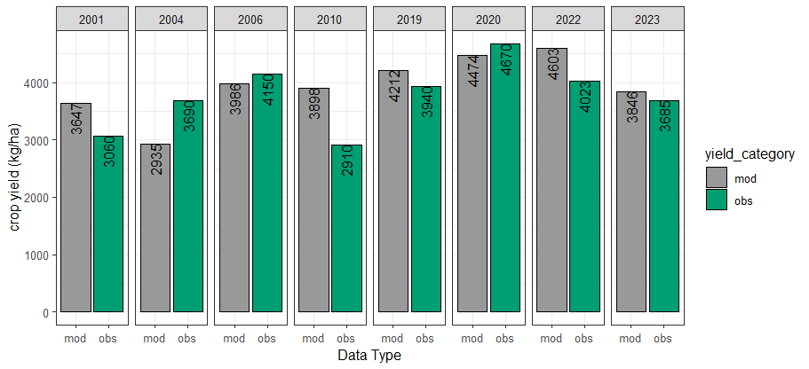
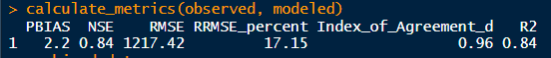

Slide 8
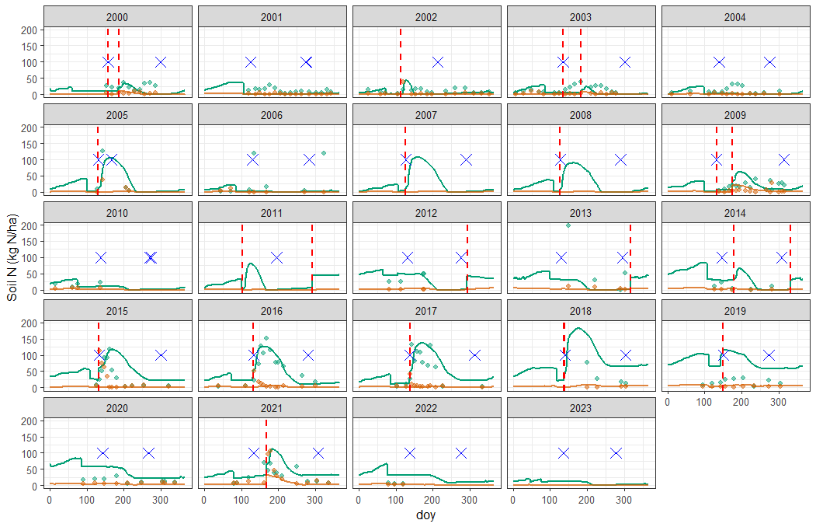

Slide 9
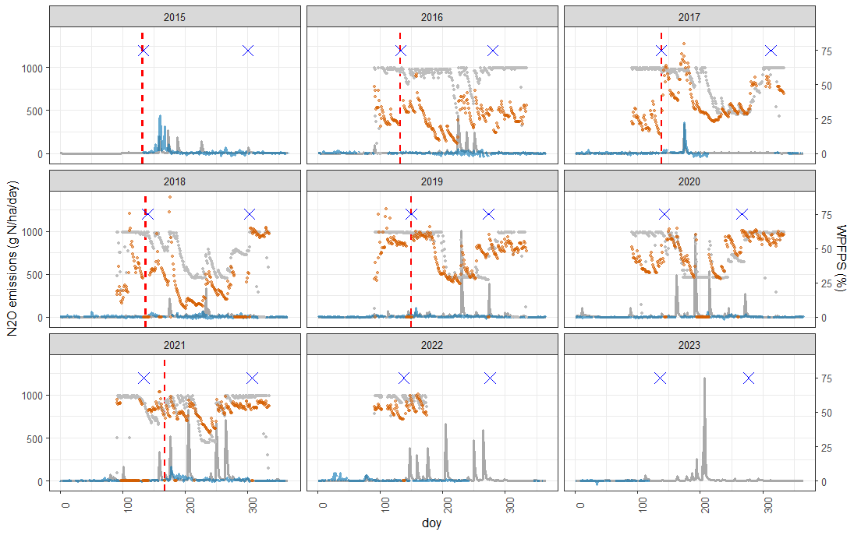

Slide 11
Preliminary results Conv vs Div rotation E26 (2018-2022) Plot 3
02/06/2025
Agustin Olivo
aolivo@uoguelph.ca

Slide 12
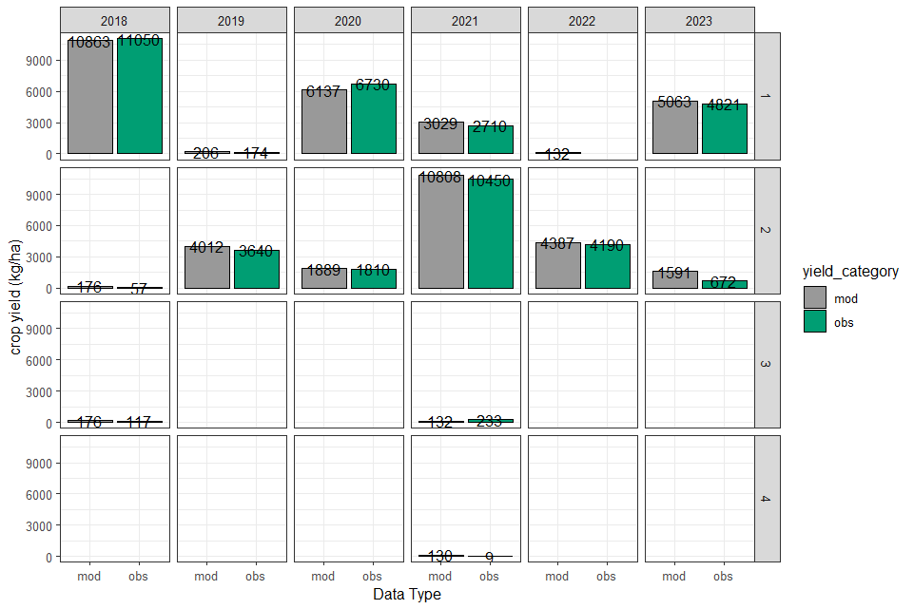
Cover crop - Rye
Wheat
Cover crop – 4-way
Cover crop - Rye
Wheat
Corn
Cover crop - Rye
Cover crop – 4-way
Soybeans
Cover crop – 4-way
Soybeans
Corn
Cover crop –
Clover
Cover crop - Rye
Cover crop –
Clover

Slide 13
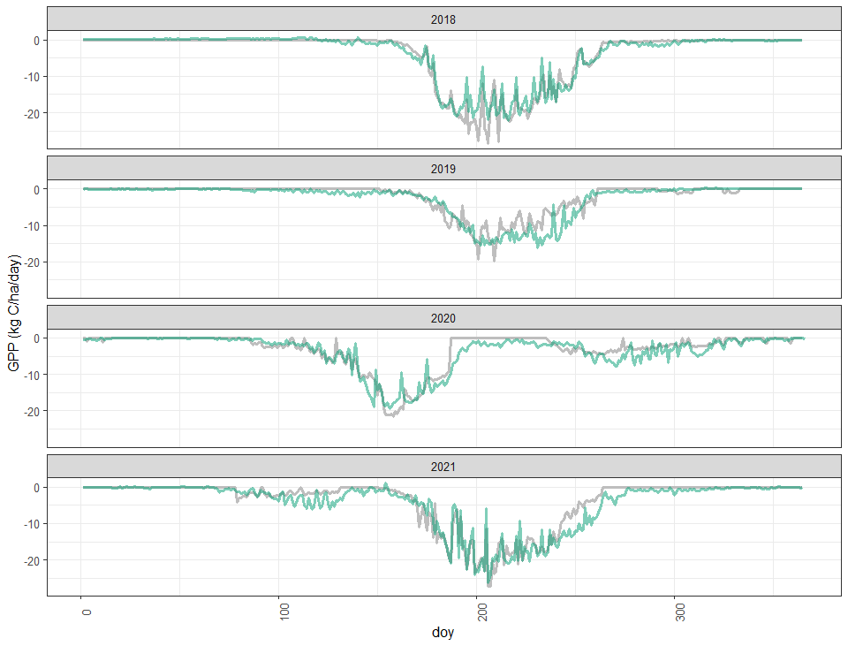
Corn
Cover crop – 2-way
Soybeans
Cover crop – 2-way
Wheat
Wheat
Cover crop – 4-way
Corn
Cover crop – 4-way
Cover crop – 2-way

Slide 15
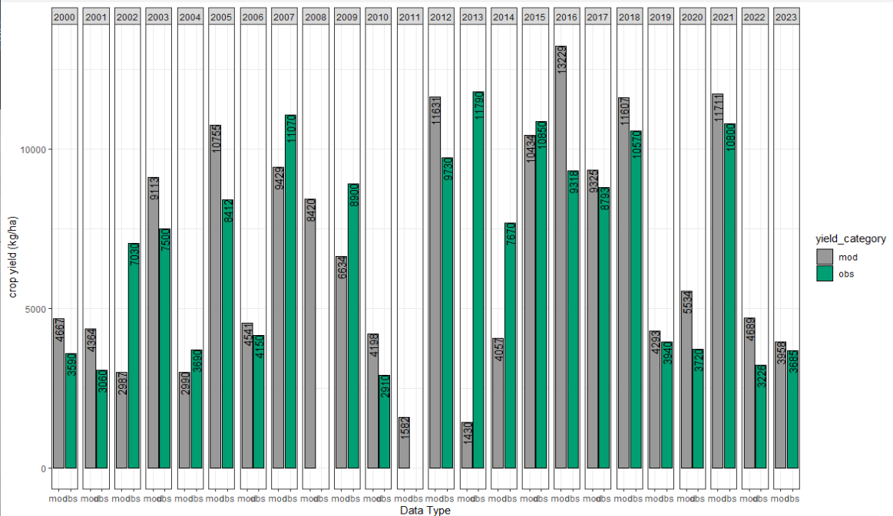

Slide 16
Preliminary results Conv vs Div rotation E26 (2018-2022) Plot 1
01/22/2025
Agustin Olivo
aolivo@uoguelph.ca

Slide 17
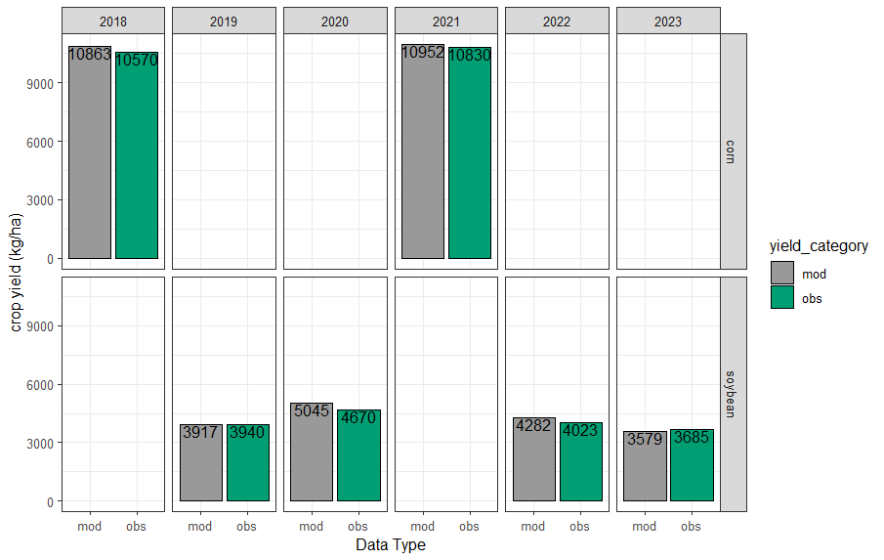
Simulated vs measured yields – conventional rotation

Slide 18
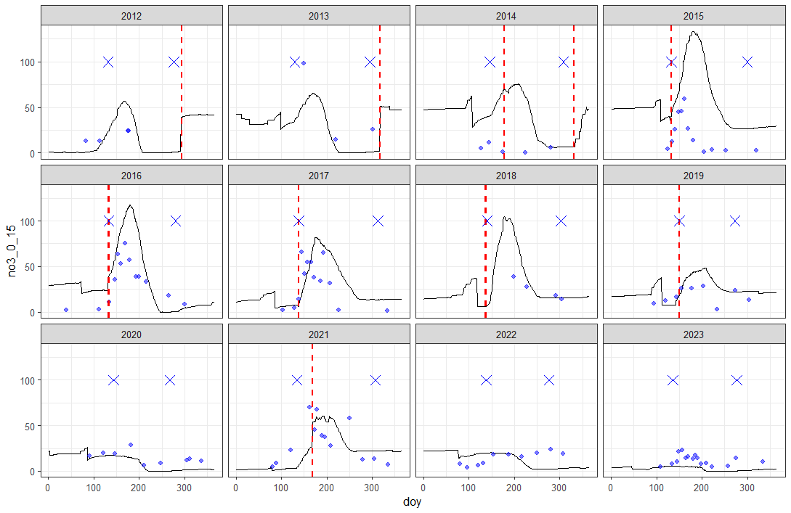
Simulated vs measured soil NO3 – conventional rotation

Slide 19
Simulated vs measured soil NO3 – conventional rotation

Slide 20
Simulated vs measured soil NO3 – conventional rotation

Slide 21
Simulated vs measured soil NO3 – conventional rotation

Slide 22
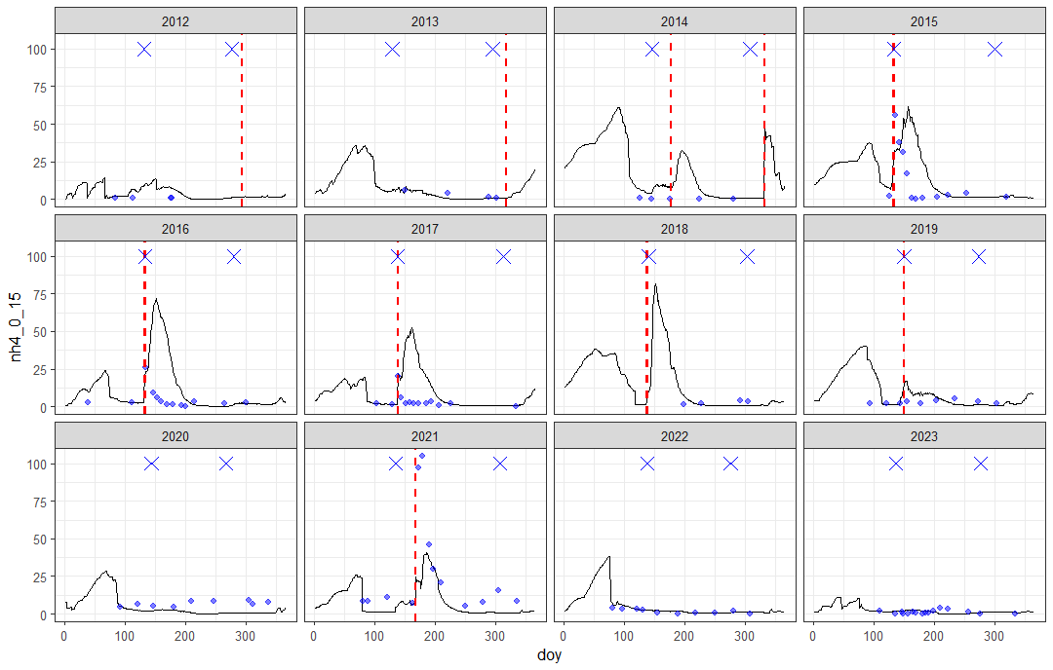
Simulated vs measured soil NH4 – conventional rotation

Slide 23
Simulated vs measured soil NH4 – conventional rotation

Slide 24
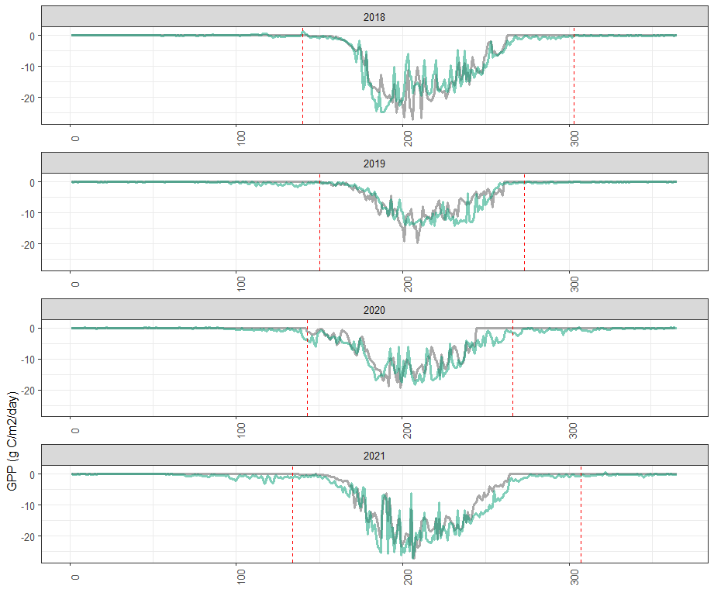

Slide 25
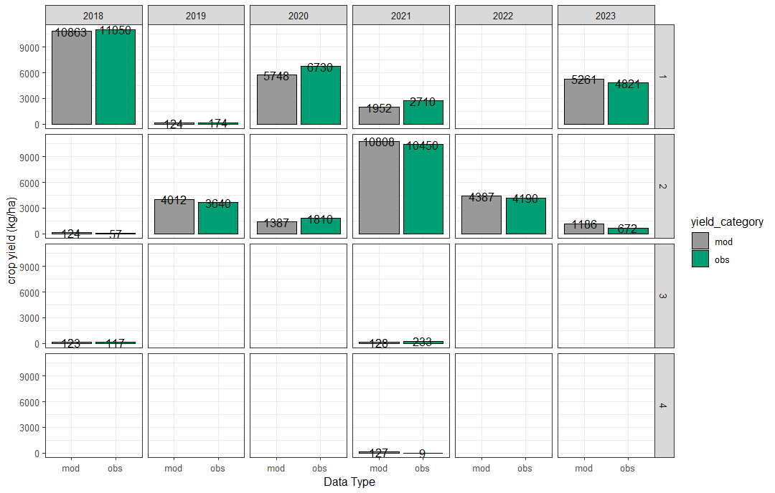
Simulated vs measured yields – diverse rotation
Wheat
Wheat

Slide 26
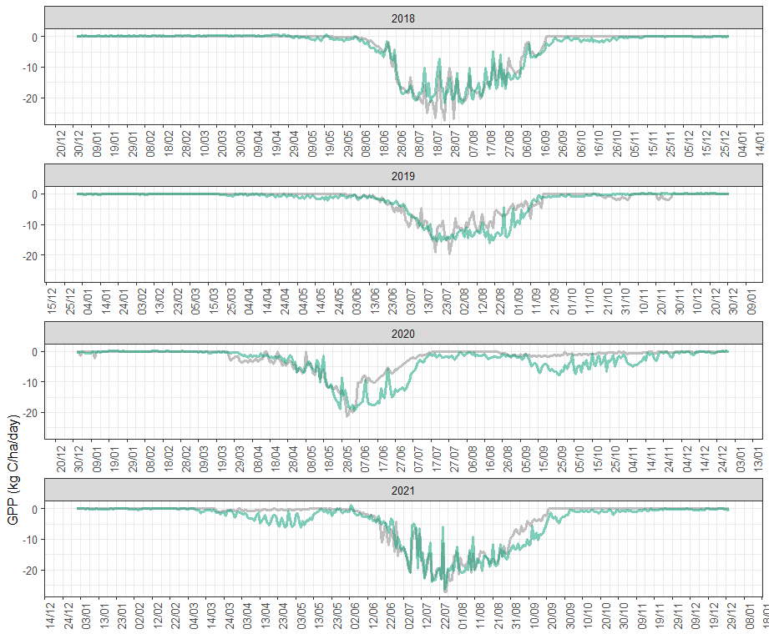
Simulated vs modeled GPP – diverse rotation

Slide 27
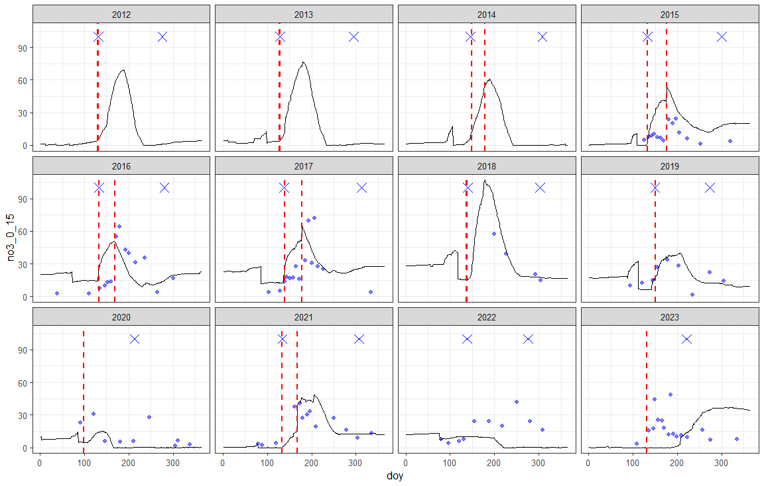
Simulated vs measured soil NO3 – diverse rotation

Slide 28
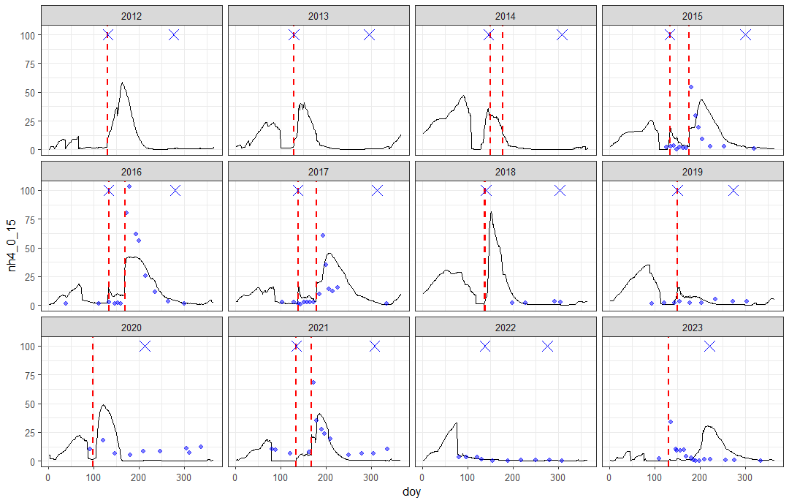
Simulated vs measured soil NH4 – diverse rotation

Slide 29
Additional items
For cover crops, it was hard to calibrate GPP and yield simultaneously

Slide 31
Preliminary results Conv vs Div rotation E26 (2018-2022) Plot 1
01/22/2025
Agustin Olivo
aolivo@uoguelph.ca

Slide 32
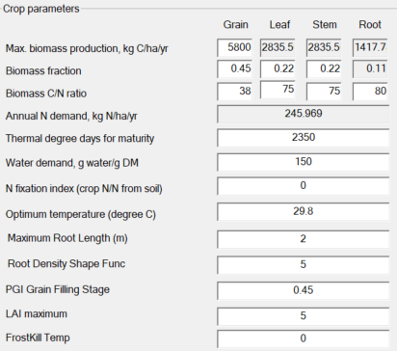
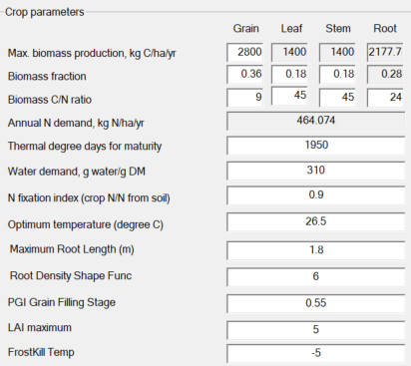
Testing corn and soybean parameters from “calibrated” conventional rotation did not hold up well in the diverse rotation file
The main issues were water and N stress (the last was most important)
The largest differences in div file between observed and modeled yields were for corn
I re-calibrated corn and soybeans considering both conventional and diverse files
New parameters for corn
New parameters for soybeans

Slide 33
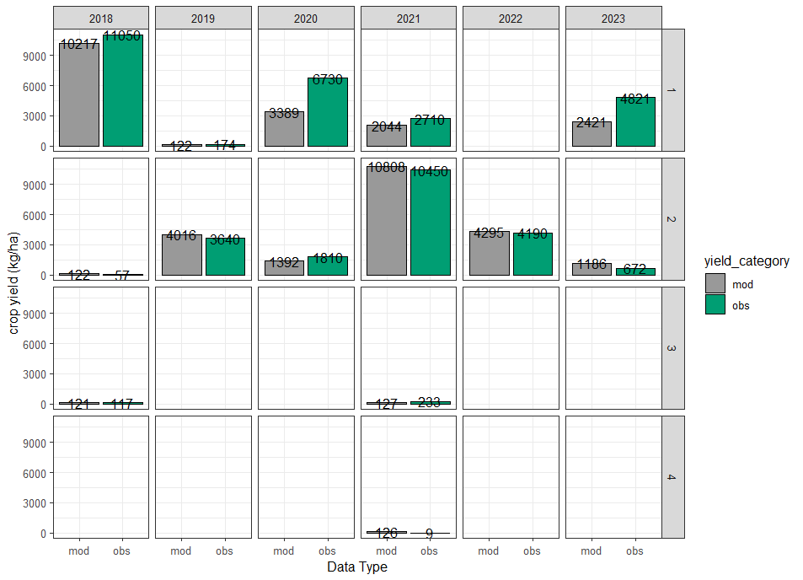
Although the new parameters ensured fit for corn and soybeans across both rotations, winter wheat was hard to calibrate, showing N stress
Cover crop
Wheat
Cover crop
Wheat
Corn
Cover crop
Cover crop
Cover crop
Soybeans
Soybeans
Corn
Cover crop
Cover crop
Cover crop

Slide 34
Although the new parameters ensured fit for corn and soybeans, winter wheat was hard to calibrate, showing large N stress
Cover crop
Wheat
Cover crop
Wheat
Corn
Cover crop
Cover crop
Cover crop
Soybeans
Soybeans
Corn
Cover crop
Cover crop
Cover crop

Slide 35
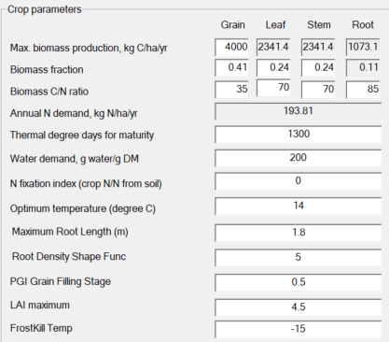
Although the new parameters ensured fit for corn and soybeans, winter wheat was hard to calibrate, showing large N stress
Cover crop
Wheat
Cover crop
Wheat
Winter wheat parameters
Corn
Cover crop
Cover crop
Cover crop
Soybeans
Soybeans
Corn
Cover crop
Cover crop
Cover crop

Slide 36
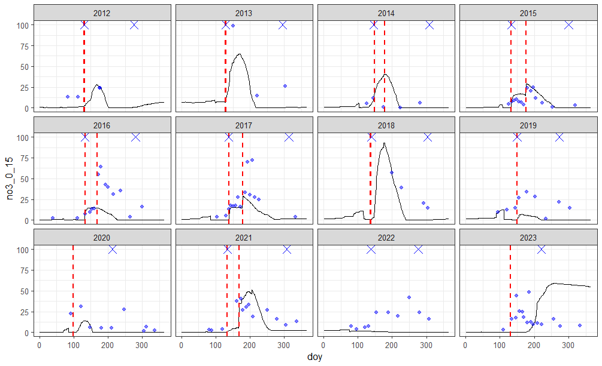
Some challenges exist with modeled NO3 values for soybean years, which make me wonder if are also related to the N stress observed for winter wheat
N application
X
Planting or harvest
Modeled soil N
Measured soil N
2012-2017: spin up
154 kg N urea
10 kg N MAP
2018-2023: main period
88 kg N urea
5 kg N starter
162 kg N UAN
103 kg N urea
Still need to figure out what is happening here, I think it is related to the cover crop set up, which I am still working on

Slide 37
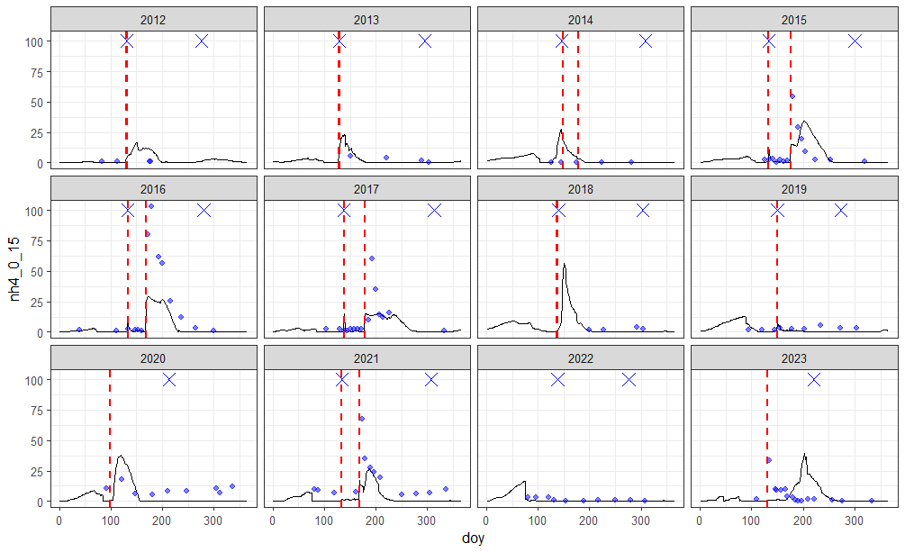
Some challenges exist with modeled NO3 values for soybean years, which make me wonder if are also related to the N stress observed for winter wheat
N application
X
Planting or harvest
Modeled soil N
Measured soil N
2012-2017: spin up
154 kg N urea
10 kg N MAP
2018-2023: main period
88 kg N urea
5 kg N starter
162 kg N UAN
103 kg N urea

Slide 38
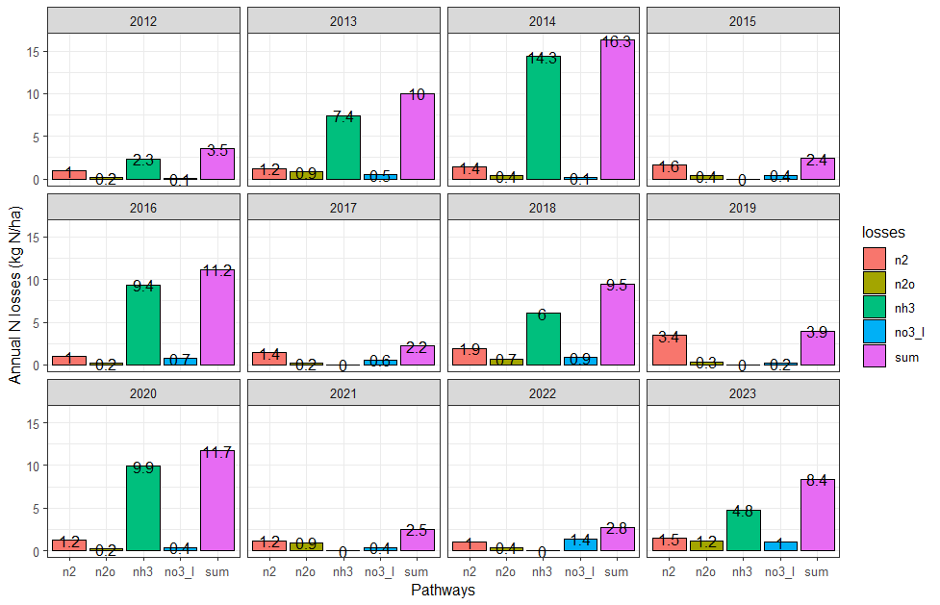
Aggregated annual N losses for diverse rotation:

Slide 39
Conventional rotation

Slide 40
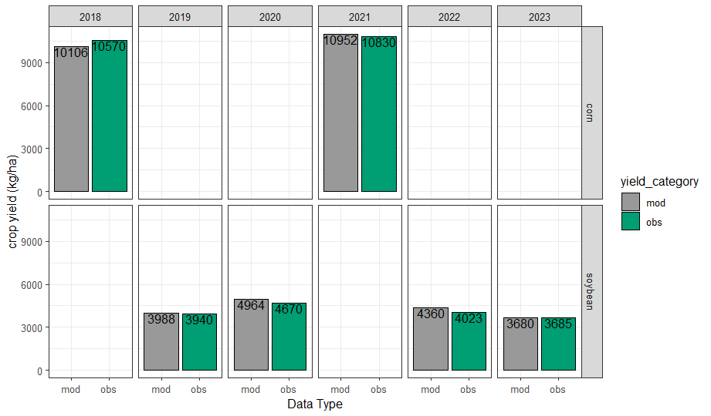

Slide 41
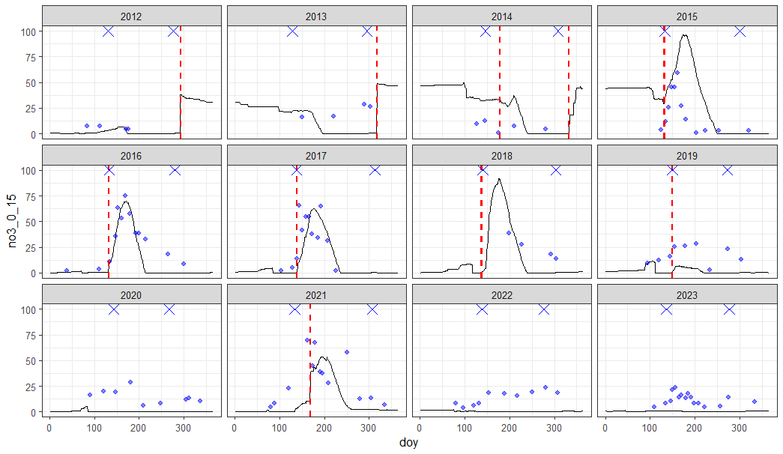
N application
X
Planting or harvest
Modeled soil N
Measured soil N
2012-2017: spin up
2018-2023: main period

Slide 42
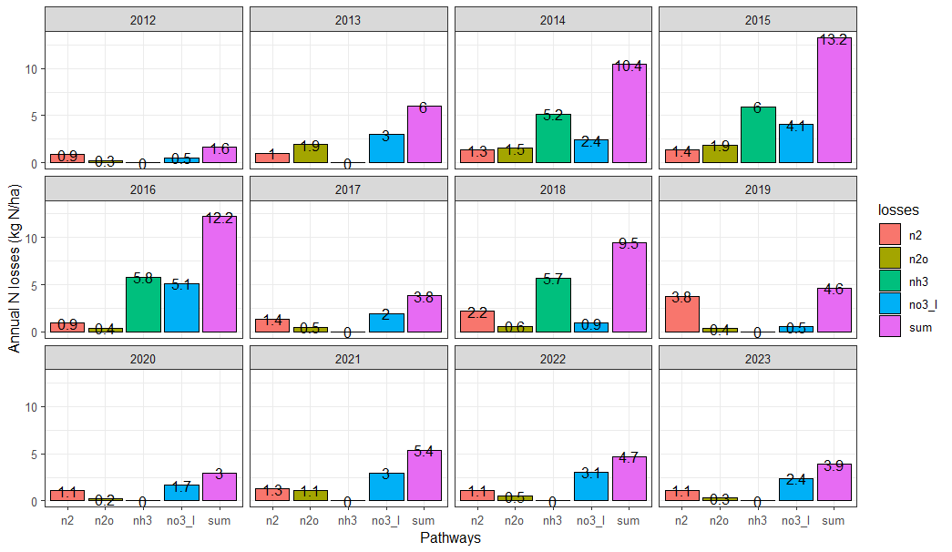

Slide 44
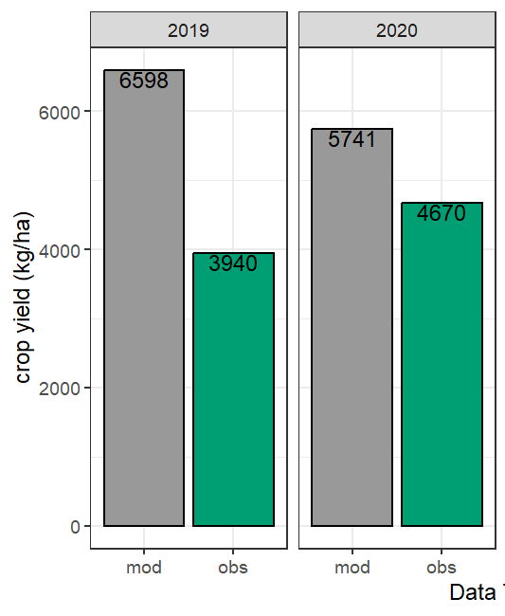
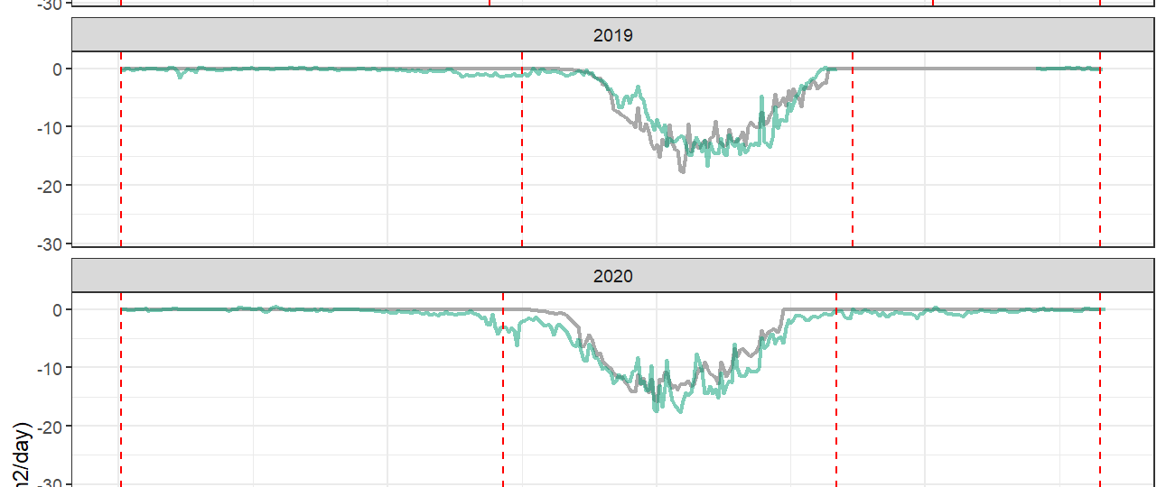
Results attempt to use crop 90 in DNDC to model soybeans

Slide 45
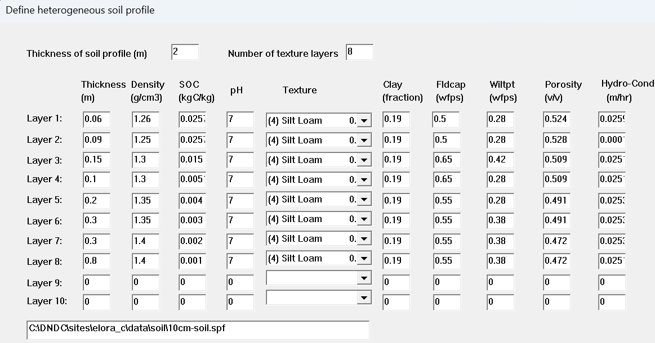
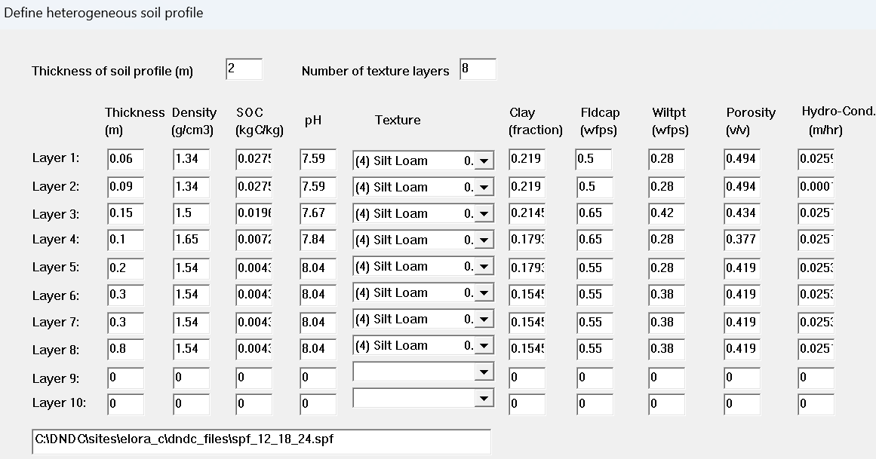
Updated soil parameters for modeling based on 2023 sampling
Old soils file
New soils file

Slide 46
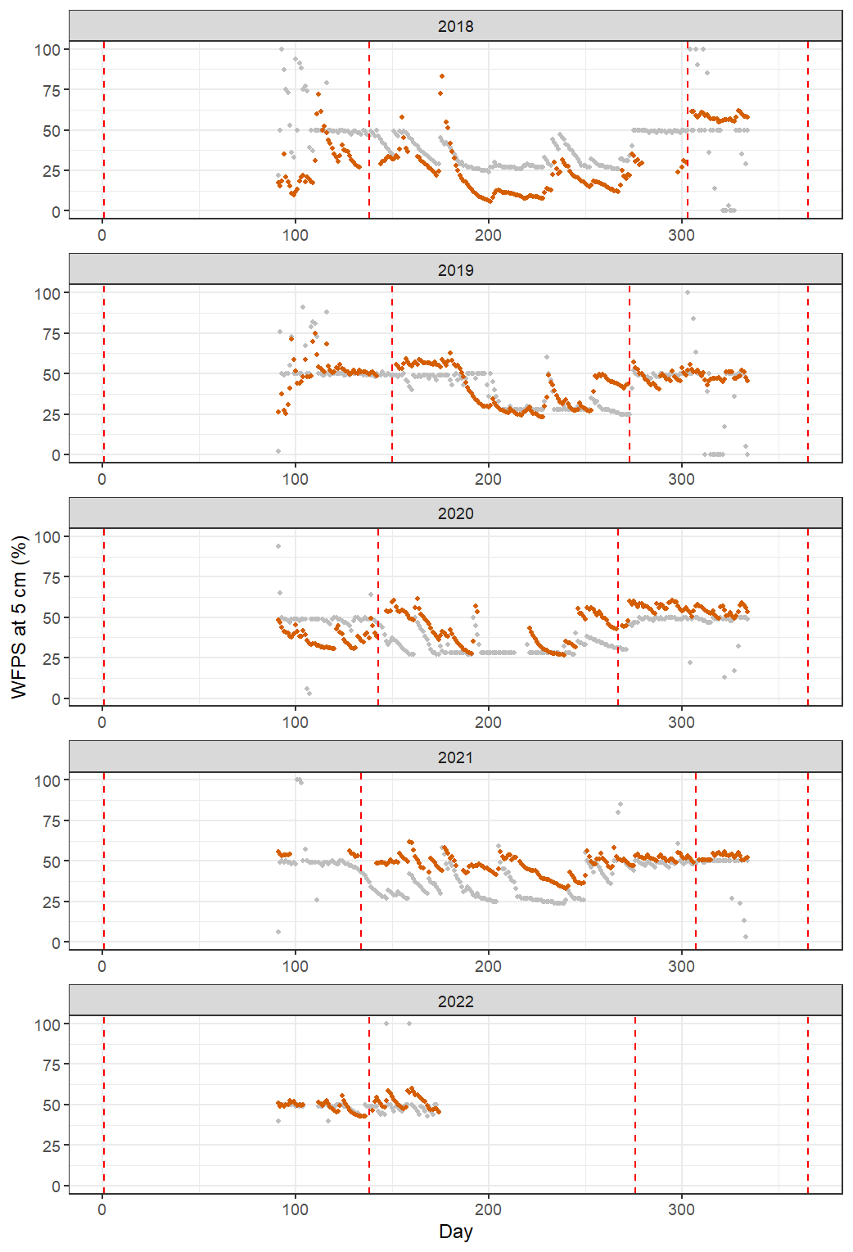
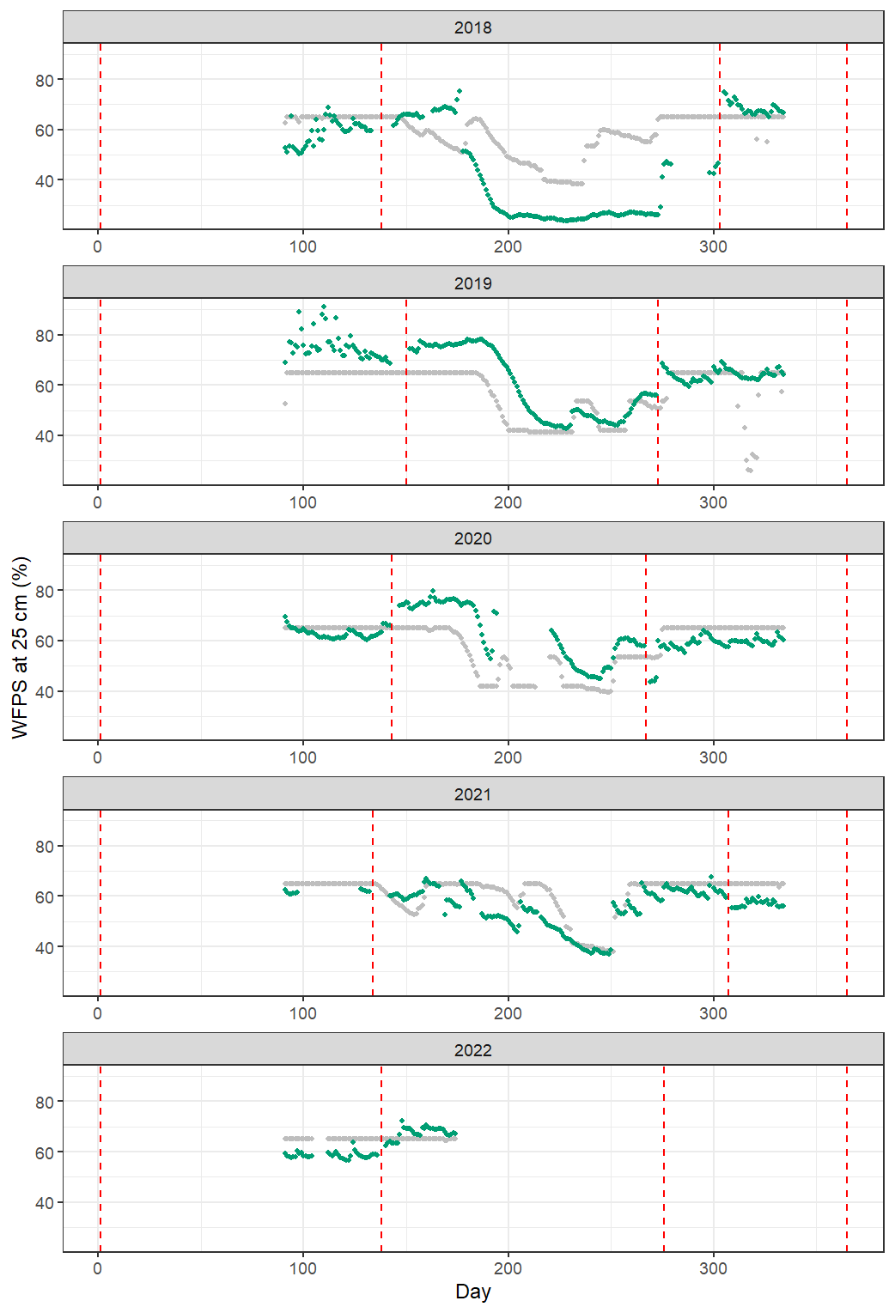
Observed vs modeled soil water after calibration

Slide 47
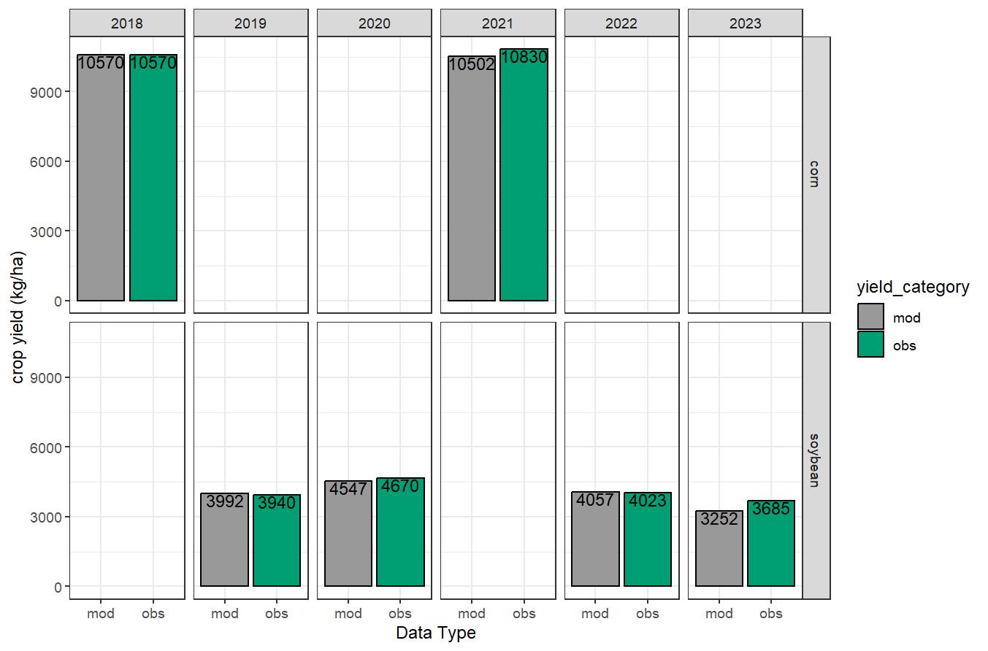
Crop yield simulation with latest calibration

Slide 48
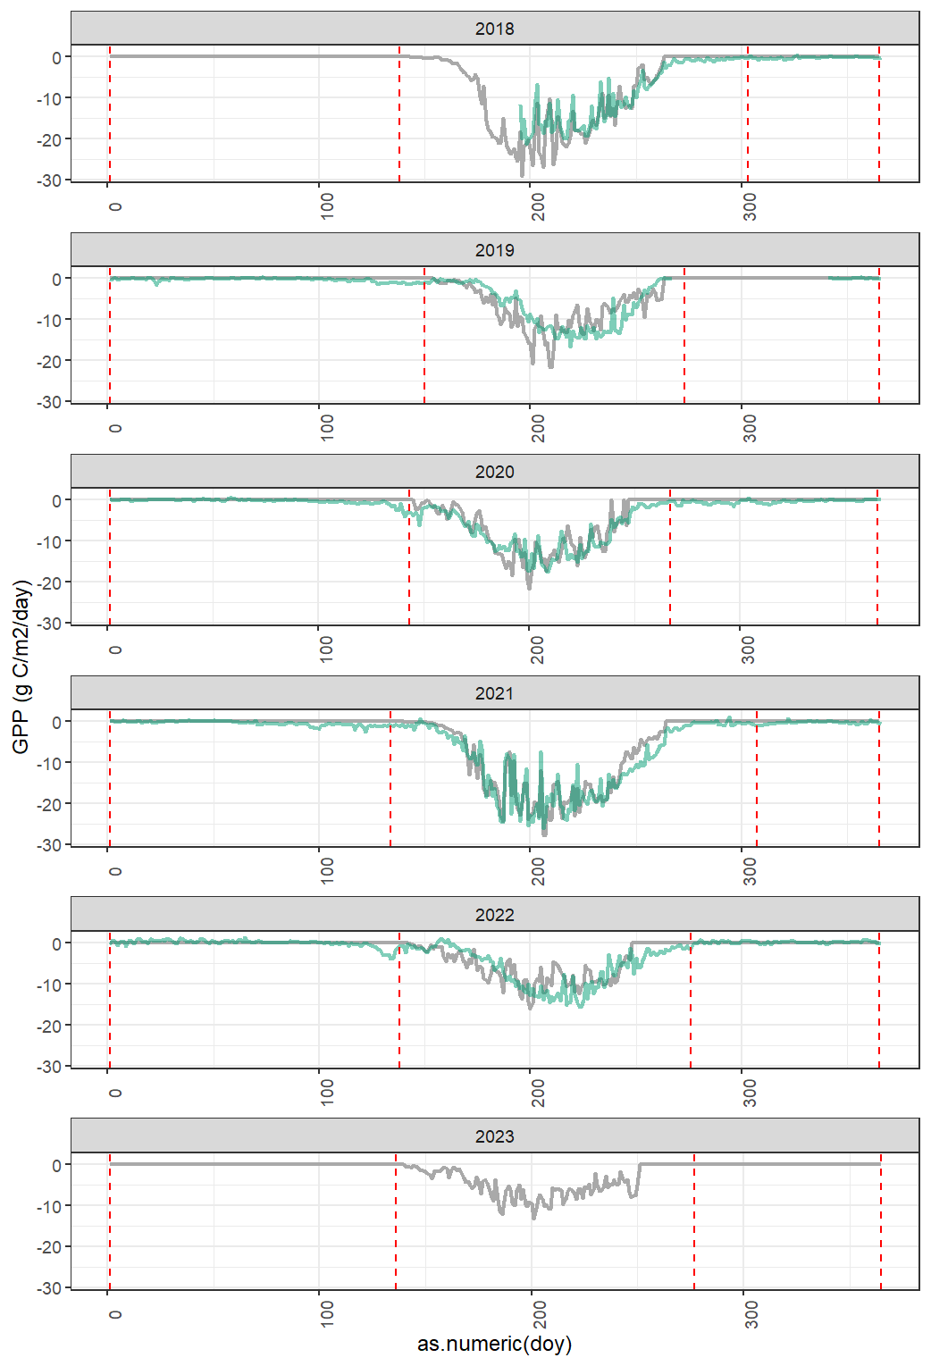
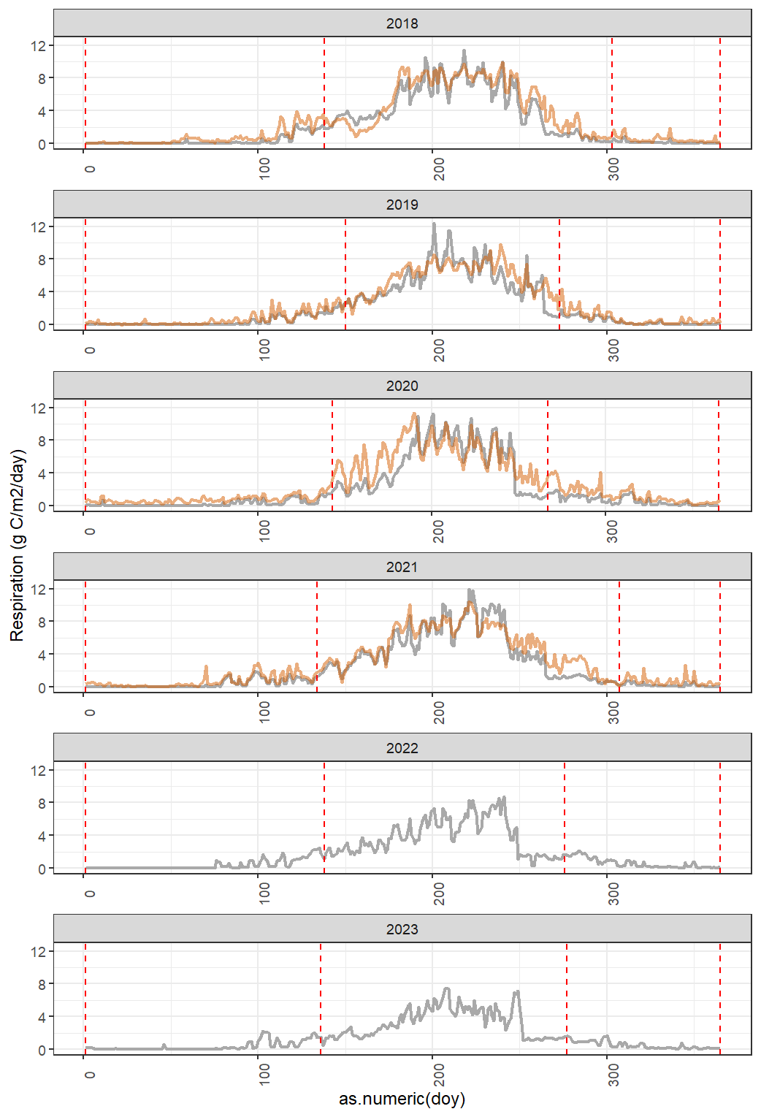
GPP and respiration with latest calibration

Slide 49
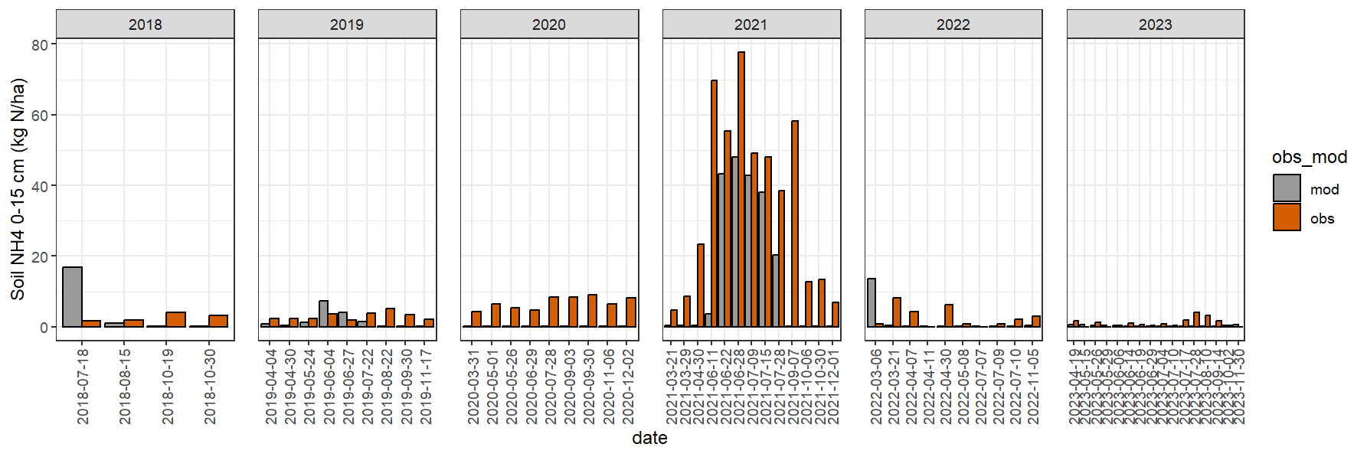
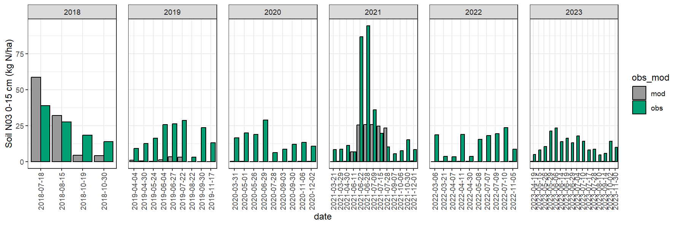
Soil N with latest calibration

Slide 50
Ideas for discussion on the approach to calibration and validation

Slide 54
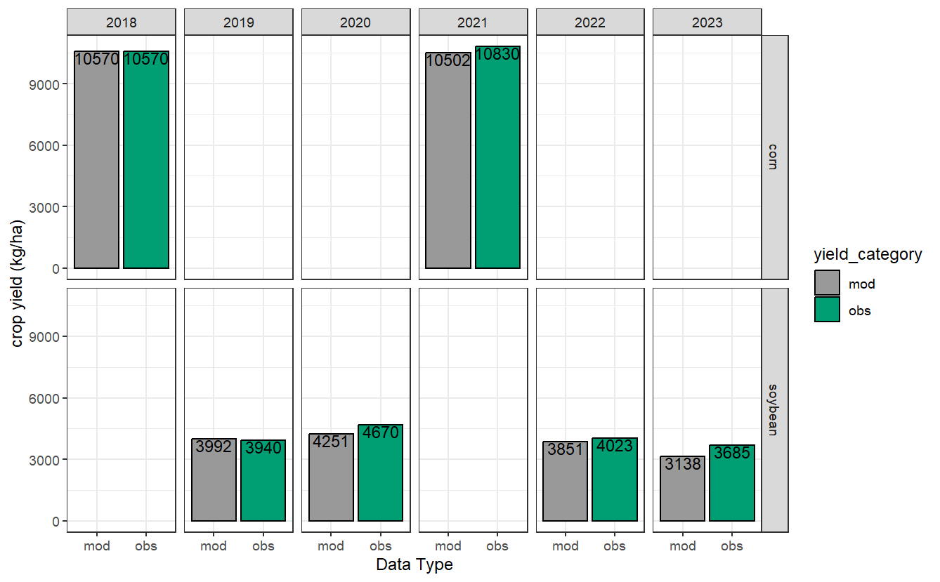

Slide 55


Slide 56
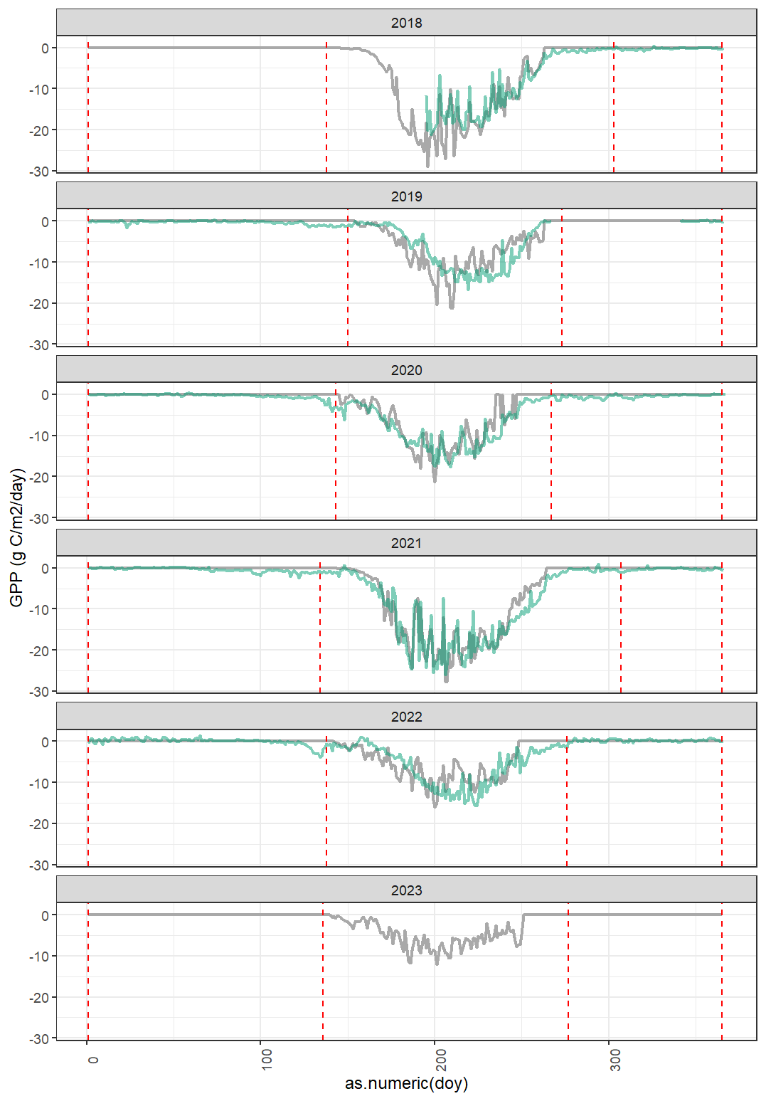
Corn
Soybeans

Slide 59


Slide 60
Preliminary results Conv vs Div rotation E26 (2018-2022) Plot 1
11/28/2024
Agustin Olivo
aolivo@uoguelph.ca

Slide 61
Conventional rotation – Corn parameters
 | Before | After
Grain C:N | 40 | 35
Leaf C:N Stem C:N | 85 | 65
Grain C content (conversion) | 0.40 | 0.42

Slide 62
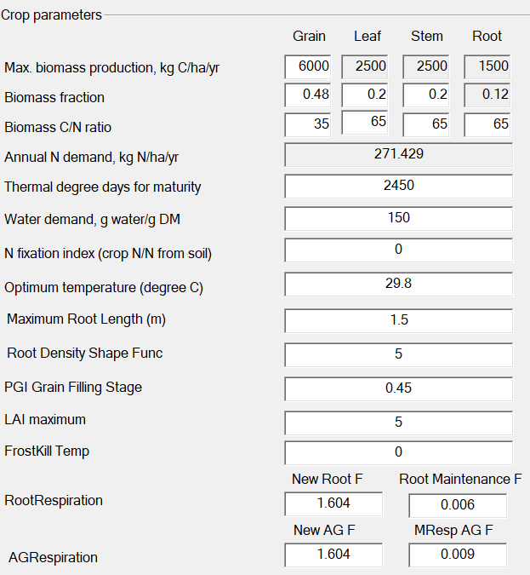
Conventional rotation – Corn parameters
 | Before | Updated based on field data
Grain C:N | 40 | 35
Leaf C:N Stem C:N | 85 | 65
Grain C content (conversion) | 0.40 | 0.42

Slide 63
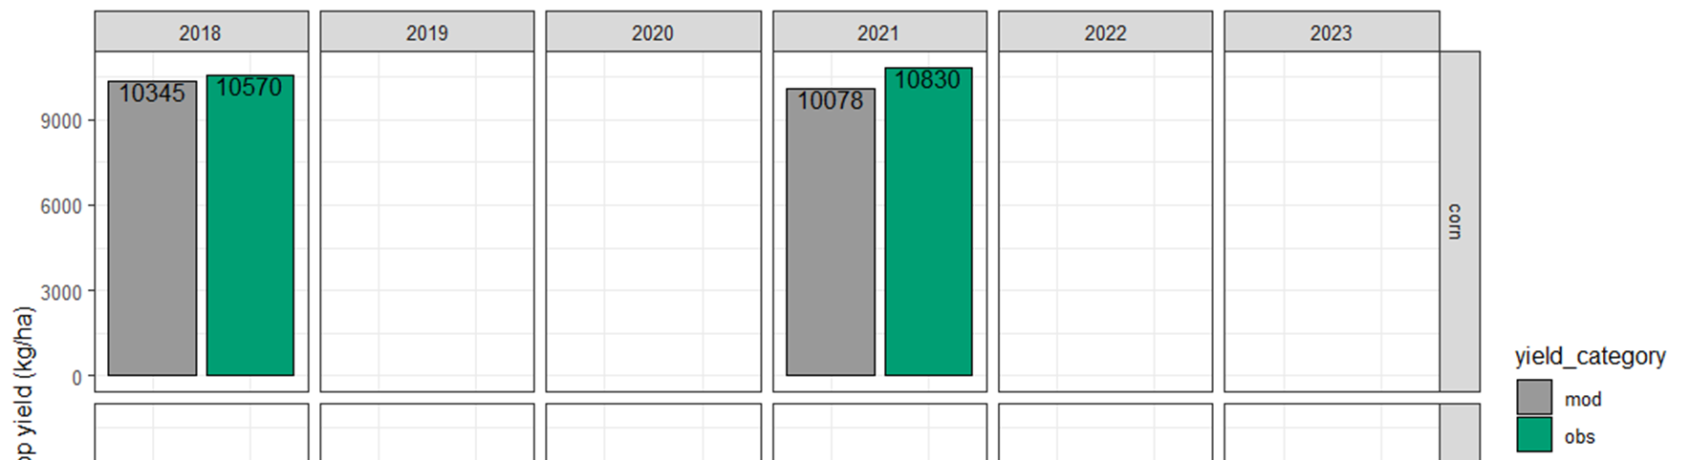
Conventional rotation – Corn yield

Slide 64
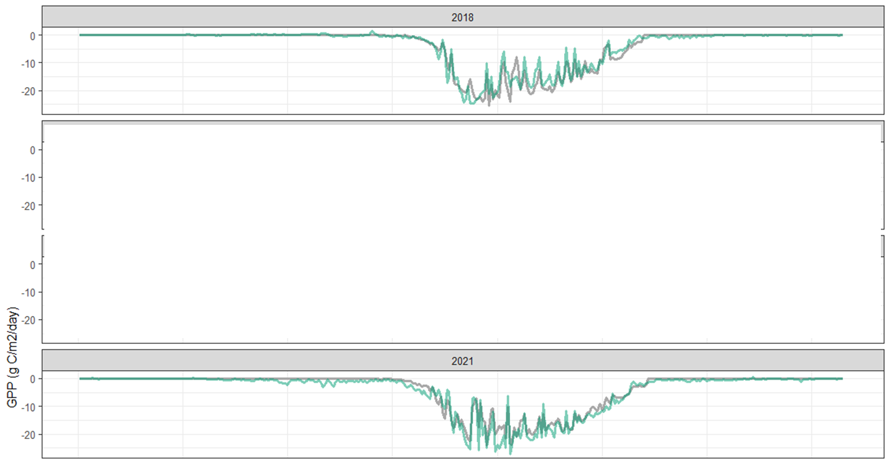
Conventional rotation – Corn GPP

Slide 65
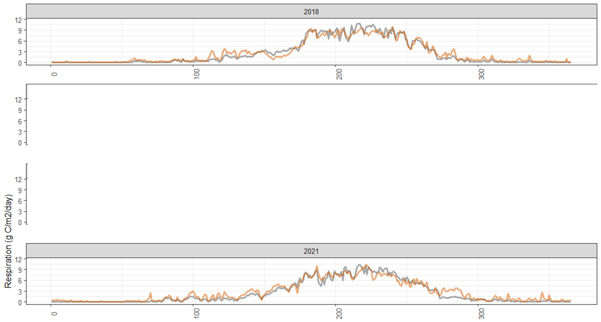
Conventional rotation – Corn resp

Slide 66
Conventional rotation – Corn parameters

Slide 67
Conventional rotation – Soybean parameters
 | Before | After
Grain C:N | 15 | 9
Leaf C:N Stem C:N | 40 | 50
Grain C content (conversion) | 0.40 | 0.50

Slide 68
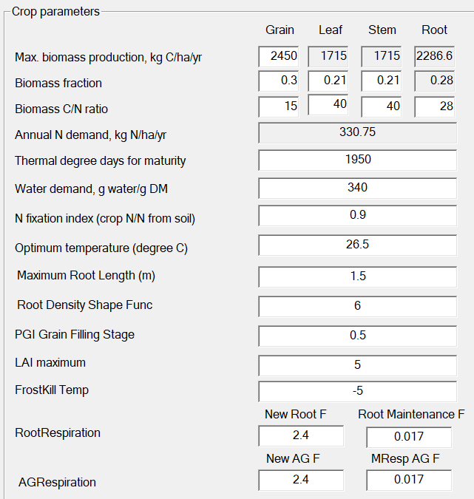
Conventional rotation – Soybean parameters
 | Before | Updated based on field data
Grain C:N | 15 | 9
Leaf C:N Stem C:N | 40 | 50
Grain C content (conversion) | 0.40 | 0.50
I could not get a good simulation with the updated values based on field data, so I kept the initial ones

Slide 69
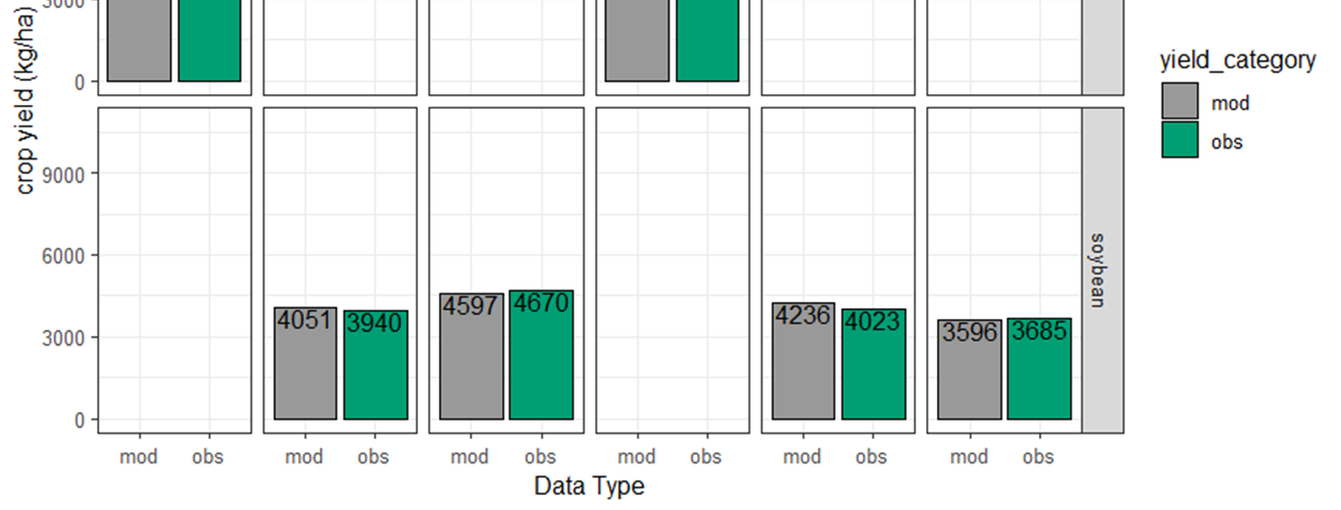
Conventional rotation – Soybean yield

Slide 70

Conventional rotation – Soybean GPP

Slide 71
Conventional rotation – Soybean parameters

Slide 76

Historic layout E26
2000-2011
1
2
3
4

Slide 77

Historic layout E26
1
2012-2014
2
3
4

Slide 78

Historic layout E26
2015-today
1
2
3
4

Slide 79

Historic layout E26
2000-2011
2012-2014
1
2015-today
2
3
1
1
2
4
3
2
3
4
4

Slide 80
1
2
3
1
1
2
4
3
2
3
4
4

Slide 81
Preliminary results Conv vs Div rotation E26 (2018-2022) Plot 1
11/21/2024
Agustin Olivo
aolivo@uoguelph.ca

Slide 82


Slide 83


Slide 84


Slide 85


Slide 89
Preliminary results Conv vs Div rotation E26 (2018-2022) Plot 1
11/15/2024
Agustin Olivo
aolivo@uoguelph.ca

Slide 90

Conventional rotation

Slide 91

GPP

Slide 92

Resp

Slide 93

NEE

Slide 94


Slide 95


Slide 96


Slide 97
Tasks:
Further calibrating corn parameters for yield/gpp?
Further calibrating corn respiration parameters for resp?
Further calibrating soybean parameters for yield/gpp?
Further calibrating soybean respiration parameters for resp?
Evaluating soil N

Slide 98


______RootResp1 1.6040 (same)
______RootResp2 0.0060 (0.0020)
______AGResp1 1.6040 (same)
______AGResp2 0.0100 (0.0010)

Slide 99

Further calibration of soybean yield
Decreasing root depth
Increasing grain fill

Slide 100

Further calibration of soybean GPP
Increasing grain fill

Slide 101


Soil N

Slide 102
Questions
How should I go about the calibration and validation of the model?
For C fluxes we have two measurements, one for diverse and another for conventional.
Maybe use 2018-2020 for calibration, and 2021-2022 for validation?
For N2O we have four plots.
What parameters would you calibrate for soil N? Nitrifier growth rate? Nitrification factor? Calibrate across the entire rotation?
What other parameters should I calibrate for N2O?

Slide 103


Slide 106


Slide 107


Slide 108


Slide 109


Slide 110



Slide 111



Slide 112




Slide 113


Slide 116

NH4

Slide 117

NO3

Slide 118
Preliminary results Conv vs Div rotation E26 (2018-2022) Plot 1
11/1/2024
Agustin Olivo
aolivo@uoguelph.ca

Slide 119


Conventional rotation:

Slide 120

Conventional rotation:
Corn
Soybean
Issue with soybean modeled GPP was resolved!
Soybean
Should I look into calibrating cropping fluxes only?
Corn

Slide 121

Diverse rotation:
Winter Wheat
4-CC
Max biomass = 20
winterkill = -15C
Trying to find out what may have happened with CC here
Winter Wheat
Rye
Max biomass = 1
winterkill = -15C
Corn
4-CC
Max biomass = 20
winterkill = -15C
4-CC
Max biomass = 20
winterkill = -15C
Rye
Max biomass = 1
winterkill = -15C
Soybeans
Soybeans
Corn
Clover
Max biomass = 1
winterkill = -2C
Rye
Max biomass = 1
winterkill = -15C

Slide 122
Diverse rotation:
Winter Wheat
4-CC
Max biomass = 20
winterkill = -15C
Trying to find out what may have happened with CC here
Winter Wheat
Rye
Max biomass = 1
winterkill = -15C
Corn
4-CC
Max biomass = 20
winterkill = -15C
4-CC
Max biomass = 20
winterkill = -15C
Rye
Max biomass = 1
winterkill = -15C
Soybeans
Soybeans
Corn
Clover
Max biomass = 1
winterkill = -2C
Rye
Max biomass = 1
winterkill = -15C
Should the max biomass be higher, and try to introduce other constraints?
Seems like DNDC does not report metrics for a 4th crop?

Slide 123

Corn
2-way cover crop
2-way cover crop
Soybeans
Winter wheat
Winter wheat
4-way cover crop
4-way cover crop
Corn

Slide 124
Preliminary results CONVENTIONAL rotation E26 (2018-2022) Plot 1
24/10/2024

Slide 125





Slide 128
Preliminary results CONVENTIONAL rotation E26 (2018-2022) Plot 1
17/10/2024

Slide 129

Issues discussed:
corn
1) Potential to improve fit of GPP during corn years.
soybeans
2) Sharp decrease in GPP in soybean years.
soybeans
2) Sharp decrease in GPP in soybean years.
corn
1) Potential to improve fit of GPP during corn years.

Slide 130


For issue 1, I run a series of scenarios for the corn years (2018, 2021) to test potential improvements:
 | 1 | 2 | 3 | 4 | 5 | 6 | 7 | 8 | 9 | 10 | 11
maximum yield | 5000 | 5500 | 4500
leaf fraction | 0.19 |  |  | 0.21 | 0.23
stem fraction | 0.19 |  |  | 0.21 | 0.23
root fraction | 0.15 |  |  | 0.15 | 0.15
grain fraction | 0.47 |  |  | 0.43 | 0.39
accumulative temperature | 2500 |  |  |  |  | 2750 | 2250
optimum temperature | 29.7 |  |  |  |  |  |  | 32.7 | 26.7
water requirement | 150 |  |  |  |  |  |  |  |  | 165 | 135
Results for yield:
Increasing max yield seems to improve yield fit.
Results for gpp:
Decreasing accumulative temp seems to improve fit.
Scenario 7 seems better for GPP, although yield shows worse metrics for that scenario; what is a reasonable compromise here? Maybe to go with scenario 7?

Slide 131



GPP for scenario 1:
GPP for scenario 3:
GPP for scenario 7:
Maybe even in scenario 7 there is still opportunities to achieve a better fit?

Slide 132


For issue 2, I explored changes in crop stress indexes and crop growth
Index
Soybean 2019
Crop growth
Index
Soybean 2020
Crop growth
In both years, it seems to be associated with water stress.
However, variables like soil water content do not seem to be particurlarly associated with this stop in growth.
Do you know how the index is calculated? I thought it could give insights into what might be the problem

Slide 133
Additional questions:
Weather data
What input does DNDC need for wind data? Speed at 2 m or at 10 m?
For precipitation, should it be total precipitation, or rain only?
Do you always set up the spin up as a single set of management practices in DNDC? Is the management of the spin-up approximately what happened in the field in the 10 years prior to modeling the experiment of interest?
In your .dnd file seems like the value for crop residue harvested varies between 0.75 and 1 for most crops; what does that depend on?
For UAN applications, I see you splitted things in 25% nitrate, 50% urea and 12.5 ammonium; is that for the split of UAN?
Do you normally switch on the "Dynamic Water Table <2" in the soil's tab of DNDC? In one of the files you shared you indicated this was used when tile drainage was present, which is the case for Elora.

Slide 134
Preliminary results DIVERSE rotation E26 (2018-2022)
Plot 3
16/10/2024

Slide 135
Measured cover crop biomass Elora E26 (2018-2021)

Slide 137
OTHER QUESTIONS

Slide 138
Preliminary results CONVENTIONAL rotation E26 (2018-2022) Plot 1
03/10/2024

Slide 139

corn
corn
soybeans
soybeans
soybeans

Slide 140

corn
corn
soybeans
soybeans
soybeans
soybeans
corn
corn

Slide 141


Slide 142
Preliminary results DIVERSE rotation E26 (2018-2022)
Plot 3
10/10/2024

Slide 143
Measured cover crop biomass Elora E26 (2018-2021)

Slide 144



Using DNDC default values for cover crops, plus calibration from conventional rotation for other crops
2-cc spring
ww
4-cc spring
corn
2-cc fall
soybeans
4-cc fall
corn
2-cc fall
There seems to be a big mismatch in cover crop biomass, particularly for the 2-species cover crop; however, results for respiration and GPP do not look terrible

Slide 145



Default cover crop option from DNDC + max grain biomass = 10
2-cc
ww
4-cc
corn
2-cc
soybeans
4-cc
corn
2-cc
Cover crop and cash crop yields comparisons seem to get closer for simulated and observed, but respiration and GPP actually show worse alignment that in the scenario from the previous slide.

Slide 146



Default cereal rye from DNDC for 2CC + default cover crop for 4CC with maximum biomass = 10
2-cc
ww
4-cc
corn
2-cc
soybeans
4-cc
corn
2-cc

Slide 147



Set up from Brian’s file for cover crops (long term file for Elora)
2-cc
ww
4-cc
corn
2-cc
soybeans
4-cc
corn
2-cc

Slide 148

Comparison model parameters

Slide 149

Comparison soybean parameters

Slide 150

Comparison corn parameters

Slide 151



Cover crop yields for rye+clover seems to be much lower than what is reported in other studies from Ontario
https://cdnsciencepub.com/doi/pdf/10.1139/cjss-2021-0070
https://cdnsciencepub.com/doi/pdf/10.1139/cjss-2021-0070

Slide 152

One cover crop entry + max grain biomass = 20

Slide 154
Preliminary results DIVERSE rotation E26 (2018-2022)
03/10/2024

Slide 155


Slide 156


Slide 157


Slide 158
Preliminary results conventional rotation E26 (2018-2022) + Questions
26/9/2024

Slide 159

Modeled vs observed yield showed good matching, but probably has opportunities for improvement

Slide 160


Temperature at 5 and 25 cm showed high level of agreement between observed and simulated data
Observed (color)
Simulated (gray)

Slide 161


Soil moisture shows large mismatch between observed and simulated data, particularly for winter months (in this period DNDC seems to simulate 0 WFPS).
I think this is because DNDC predicts water is in the form of ice and predicts 0 WFPS then (with liquid water). Did you run into this in the past? In case yes, do you know of any model parameters that can be tunned to improve the fit?
The model seems to be doing relatively well for soil water during the cropping season

Slide 162


Soil nitrogen also seems to have opportunities for improvement; mismatch is potentially linked to the differences observed for soil water.
The mismatch seems to be particularly relevant in soybean years (2019-2020)
The mismatch seems to be particularly relevant in soybean years (2019-2020)
What variables could be calibrated in the model to improve soil N dynamics?

Slide 163

Respiration seems to show a decent fit, with error metrics matching previous published studies
Observed (color)
Simulated (gray)

Slide 164

Gross primary production seems to have opportunities for fit improvement.
Observed (color)
Simulated (gray)
Model predicts GPP = 0 or very low for some summer days; is that realistic?

Slide 165

For N₂O, error metrics seem comparable to previous studies, although it may have opportunities to improve
Observed (color)
Simulated (gray)

Slide 166
Additional Questions
Nirmani and I discussed calibrating DNDC comparing simulated vs observed data with plots 1 and 3, and then validating with plots 2 and 4. However, in 2021 plot 1 has differentt management than 2, and plot 3 has different management than 4 (with and without N use inhibitors); would it still be fair to use plots for calibration and validation as outlined?
DNDC
In Azeem's files, wilting point is set up at 0.38 wfps (soil's tab); it seems to be lower in other files I have seen (0.07;0.08); is 0.38 correct?
The current porosity in the soil's tab we have on file for the field is 0.54; however, when calculating it with the following equation: bulk density listed in the mode for E26 (1.2)/particle density (2.65) = 0.45; should the porosity be set to be around 0.45?
I think Elora has tile drainage. Based on my understanding, I think that means we should be selecting "Dynamic water table <2 m" in the soils tab; is that correct? I do not think I saw it was selected in previous files.
Why is the residue left in the field set to 0.75 for corn crops in previous DNDC files? Shouldn't it be 1? (crops tab)
Should we be using the CO2 increase rate option in the model? (Climate tab)
When fertilizer is incorporated through disking, should we use "surface" application with an 15 cm depth, or the injection option?
How does the calibration process exactly work? What I have been trying is to play with some key variables one at a time in the model (varying the values +-20%), and then check what was the impact on RMSE(%) for the variables of interest (N2O fluxes, CO2 fluxes, GPP, yield, and soil water). I am not sure how I should exactly proceed with this information: should I re-set parameter values to the ones showing the lowest error values all at once after running scenarios, or should I follow more of a sequential change of parameters where I test values +-20% for one parameter, choose the best option and then continuing with the next parameter, and so on?
For calibration, I chose to test calibrating all corn years in the rotation together, and then all soybean years together. This would result in a single set of parameters for each crop for all the modeling exercise. Does that sound correct?

Slide 167

Questions
DNDC
I noticed that some of the values in the “tile drain and model parms” differ between the file that Azeem shared (modeling for 2015-2017), compared to those suggested by Brian in a document that he shared with Nirmani some time ago (see table, and colored values). I imagine some of that is due to calibration, but I was curious how you got those values.

Slide 169

Photosynthesis model predictions for soybeans in summer 2020; there are some weird model predictions equivalent to 0. These ones particularly happen in July 2020.
There are similar situations in 2019.

Slide 170
Meeting DNDC modeling 12/09/2024
Agenda
Project introductions / description of current state
Updates on long-term modeling project Brian is doing for E26 (Nirmani).
Modeling of N2O in lysimeters (Sam).
Modeling of CO2 fluxes in E26 for period 2018-2023 (Agustin).
Modeling inhibitors studies (Azeem).
Discussion of areas of overlap.
Questions from Agustin (see following slides).

Slide 171
Questions from Agustin
• How many years of spin up should we consider? 3? 4? 6?
• How precise does the data entry for the spin up have to be?
• For NO3 and NH4, seems like the DNDC outputs are every 10 cm (0-10; 10-20,etc); however, the data from the field are from 0-15 cm; how should we handle this?
• While playing around with DNDC I run into big discrepancies between observed and modeled data, when using the "Heterogeneous profile" in the soil's tab (which, if I understood correctly, considers the specific soil data we have for the site in the .spf file); however, when I choose the "top soil (0-10cm) texture" option instead of "Heterogeneous profile", the temperature at 10-20 cm gives very weird values. Did you run into anything like this?
• Do you use different conversion factors between yield and grain C for different crops?
• For fertilizer incorporation, should we use "surface" application in the fertilizer tab with an 10 cm depth, or should we choose the injection option?
• In the case of starter fertilizer application, do you consider that as "injected" in the model.
For some years, starter was applied; I picked the planting day for this fertilization, but was wondering how the placement of the fertilizer should be entered
• For my last run of DNDC for the period 2018-2022 (for which modeled yields, and grain C got relatively close to observed values), I am sending in the next slide a few screenshots of the crop parameters I ended up with; do those parameters look similar to the ones you have been using for Elora in your project?
I am also sharing below some of the first outputs from DNDC; modeled soil temperature seems to be close to the observed values. However, for WFPS there are big discrepancies; did you run into anything like this before?

Slide 172


Crop parameters for corn
Crop parameters for soybeans

Slide 173

Grain C

Slide 174

Soil temperature (5 cm)
Observed
Modeled

Slide 175

Soil temperature (25 cm)
Observed
Modeled

Slide 176

WFPS (5 cm)
Observed
Modeled

Slide 177

WFPS (25 cm)
Observed
Modeled

